Slide 1

Influencer Detection System

Slide 2
Overview
Influencer detection is the process of using data analytics to identify individuals who can sway the opinions and behaviors of others within a specific target audience. It involves analyzing social media and online data to find people with a significant and engaged following, helping brands find the best influencers for their marketing campaigns.

Slide 3


Slide 4
Credibility
Engagement
Authenticity
Influencers build trust with their audience over time. When they endorse a product or service, their followers are more likely to believe in its quality and effectiveness.
Influencers who have an engaged audience (i.e., followers who actively like, comment, and share their content) can help create a deeper connection with your brand.
Authenticity is key in influencer marketing. The right influencers will naturally align with your brand values and messaging, making their endorsements more authentic and believable.

Slide 5

Network Analysis of Social Media Platform YOUTUBE

Slide 6






Identifying Relevant Influencers
Optimizing Campaigns
Measuring Reach
Monitoring Trends
Building Relationships
Assessing Engagement

Slide 7

Employing ML algorithms and performing Exploratory Data Analysis on YOUTUBE dataset

Slide 8
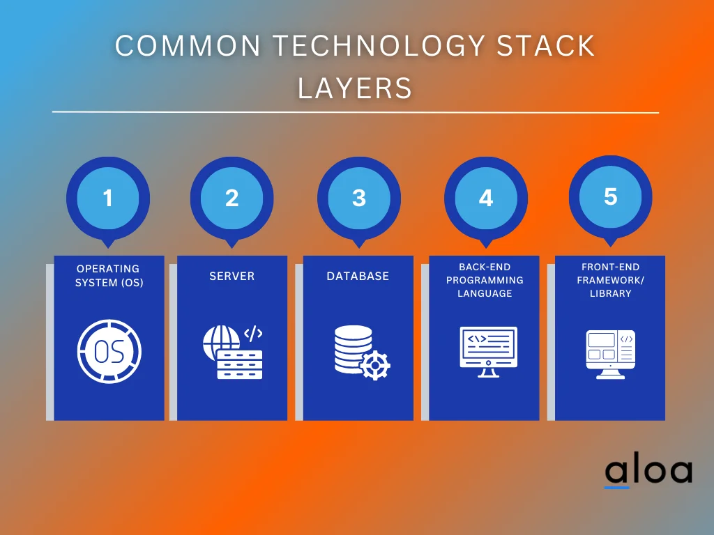











Technology Stack

Slide 9
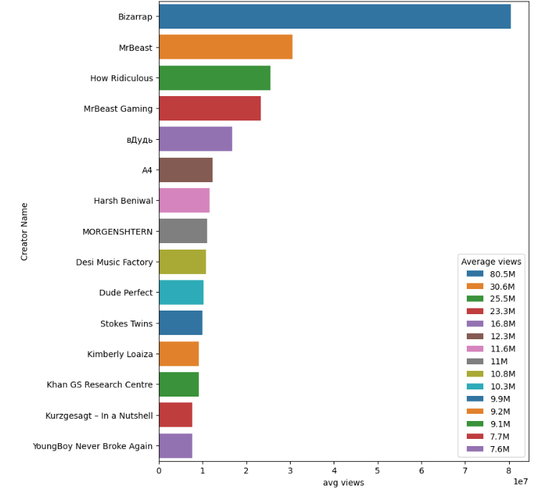
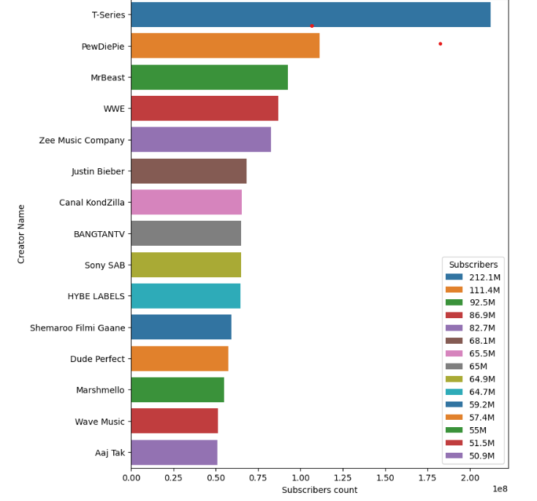
Most Followed Youtubers
Most viewed Youtubers

Slide 10
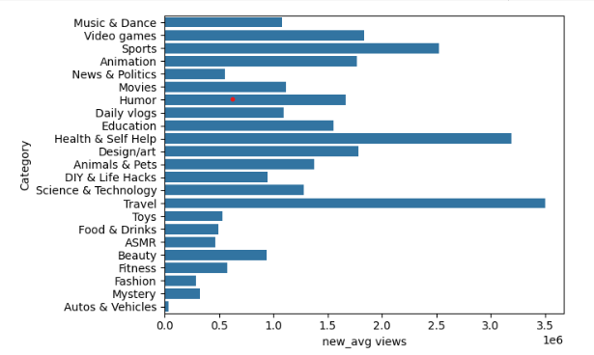
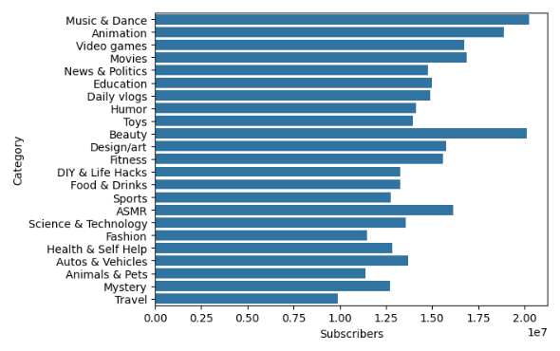
Most viewed categories
Categories with most subscribers

Slide 11
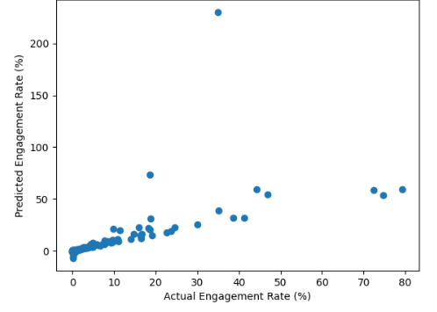
Actual vs Predicted Engagement Rate

Slide 12
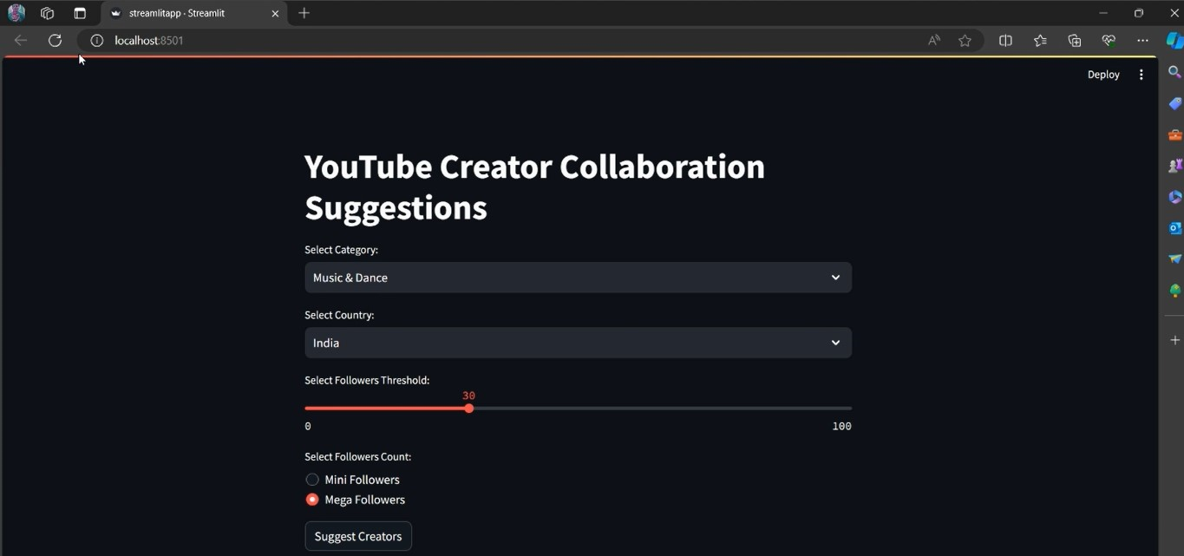
Product

Slide 13
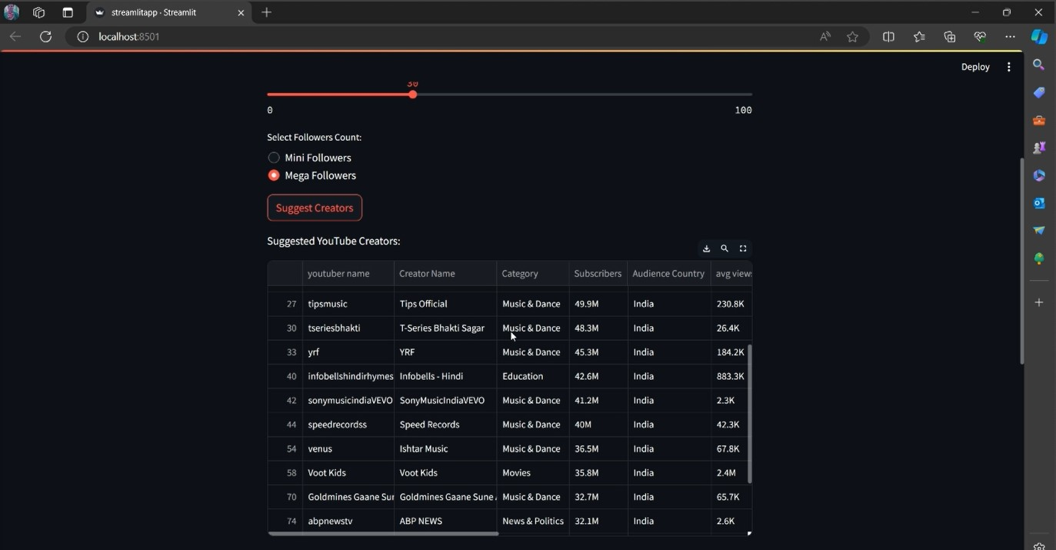
Suggestions according to the threshold set by the user

Slide 14
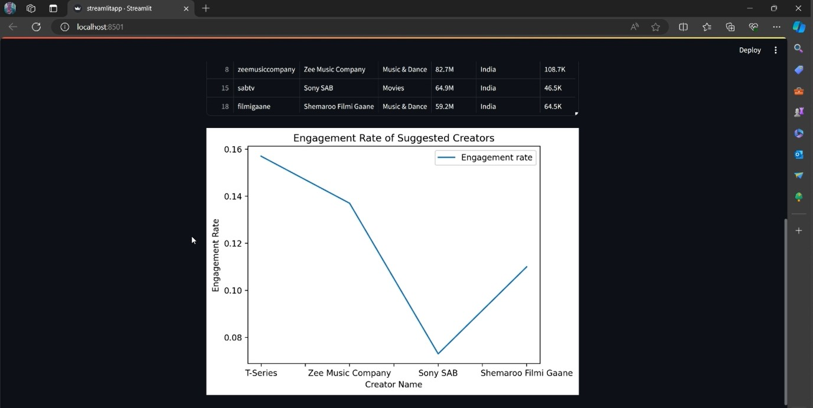
Visualizations

Slide 15
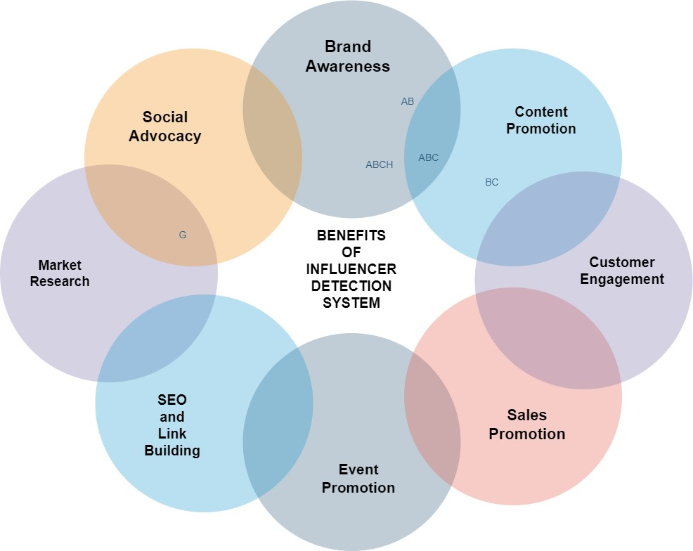

Slide 16

Thank You
Reach out to us for any queries.

Slide 17
Presented by:
Priyanshi Agrawal , 0206AL211073
Raunak Jain, 0206AL211079
Rupali Choudhary , 0206AL211083
Shambhavi Mishra , 0206AL211100
Tanmay Agrawal , 0206AL211125
6th SEM,AIML-2
AL-608 ,Minor Project
Session 2023-24
Presented to:
Prof. Saurabh Kapoor

